Slide 1
Jermyn Borough Council Meeting
10/17/2023

Slide 2

Meeting Agenda
October 17, ,2023
CALL TO ORDER
PLEDGE OF ALLEGIANCE
ROLL CALL
PREVIOUS MEETING MINUTES
TREASURER REPORT/BILLS PAYABLE
SECRETARY REPORT
CORRESPONDENCE
PUBLIC COMMMENT
PROFESSIONAL REPORTS-POLICE,FIRE,SOLICITOR,ZONING,ENGINEER,TAX COLLECTOR,MAYOR
COMMITTEE REPORTS-SAFETY,PLANNING,FINANCE,SHADE TREE,REC,MS4,DPW
MELLOW COURT PAVING AWARD
NORLACK AGREEMENT
BUDGET DISCUSSION
POLICE PENSION PLAN
EXECUTIVE SESSION FOR PERSONNEL ISSUES
POLICE CHIEF CONTRACT
POLICE OFFICERS EMPLOYMENT CONTRACT
NEW BUSINESS

Slide 3
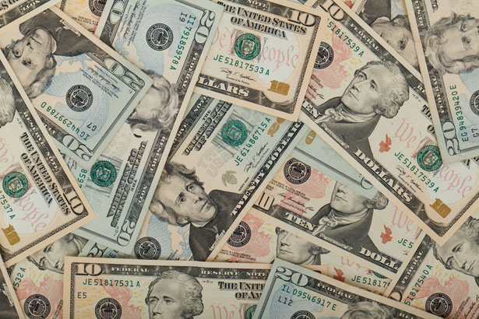
Treasurer’s report
10/17/2023
ASSETS
Checking/Savings
American Rescue Plan Fund 135,730.39
Capital Reserve - DPW 729.48
Capital Reserve - Police 5,339.82
Crime Watch Fund 222.69
General Fund - Community 102,175.61
General Fund - FNB 6,659.52
Holiday Lights Fund 1,459.09

Slide 4
Treasurer’s report
Investment - General Fund 1,050.24
Investment - Liquid Fuels 23,124.18
Investment - Paving Fund 1,061.17
Investment - Recycling 116.00
Investment - Refuse 165.39
Liquid Fuels - FNB 35,512.56
Petty Cash 223.00
Recreations Fund 28,537.25
Recycling - Community 3,163.93
Refuse Checking - FNB 130,871.85
Total Checking/Savings 476,142.17

Slide 5
Treasurer’s report
200000 · Accounts Payable 7,957.17
Long Term Debt 160,467.74

Slide 6


